Slide 1
digging into the data
7/27/16
Lassiter High School
Science Dept.
Teacher Kick-Off

Slide 2
Welcome back to the 2016-2017 school year!
As we kick off this new school year, let’s take some time to delve into the data of our students and make a plan to make this the best school year yet!
The majority of our students are already performing at or above proficiency on many district, state, and nationwide assessments, but…how can we move more students into the above proficiency category?
Keep this question in mind as we progress through this presentation.

Slide 3
Demographics
Before we start reviewing assessments, lets look at our students.
Our demographics have stayed constant…but expect some changes this year!
Notes:
http://www.schooldigger.com/go/GA/schools/0129001881/school.aspx
http://www.publicschoolreview.com/lassiter-high-school-profile

Slide 4
enrollment
Before we start reviewing assessments, lets look at our students.
Notes:
http://www.schooldigger.com/go/GA/schools/0129001881/school.aspx
http://www.publicschoolreview.com/lassiter-high-school-profile

Slide 5
What to Expect in 2016?
More school of choice and transfer students
STEM program alone has 41 students from outside of district
Increase in local housing is also contributing to increasing enrollment
How can we support these students as they make the transition to our school?

Slide 6
End of course (EOC) tests
Students an EOC in Algebra, Geometry, 9th Lit, American Lit, U.S. History, Econ, and Biology
With the introduction of the new Georgia Milestones Test, more students are struggling to score above proficiency.

Slide 7
End of course (EOC) tests
How does our data compare at the county level?

Slide 8
End of course (EOC) tests
How do we compare at the state level?
Well above the state scores in these two categories! Great job Biology team!!!

Slide 9
End of course (EOC) tests
Our Biology team and the scores of their students is our strength in the department, how can the biology teachers help the rest of the department with instructional techniques and best practices?
Best in the county!!!
Notes:
https://www.gadoe.org/Curriculum-Instruction-and-Assessment/Assessment/Pages/Georgia-Milestones-Statewide-Scores.aspx

Slide 10
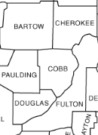
End of course (EOC) tests
How does Cobb compare to surrounding counties?

Slide 11
How can science contribute elsewhere?
Now that we’ve looked at the Milestones EOC Biology test, which is a strength within our department, let’s look at other assessments our students are taking.
Science instruction and learning can contribute to specific reading, writing, and math assessments as well as the PSAT, ACT, and SAT.

Slide 12
11th Grade writing test
How can we help improve these scores through our science classes?

Slide 13
AP Testing – TWO Areas of improvement
Number of students taking the AP exams
Improve student scores on AP exams
Decrease
Decrease

Slide 14
PSAT Testing
The new PSAT was launched in the spring of 2015 and we have not been able to analyze this data yet, but prior to this test, our students were still struggling with the writing portion.
Room for improvement here

Slide 15
ACT Testing
Students have continued to demonstrate a consistent increase in overall ACT scores.
It is essential that we keep implementing ACT practice test science questions into our courses to continue this upward trend!

Slide 16
sat Testing
Students have continued to demonstrate a consistent increase in overall SAT scores.
With the new SAT format in 2016, students are now expected to demonstrate deeper critical thinking, better problem solving, and improved writing abilities.
We must continue to teach and refine these skills in our students in the classroom.
Great upward trend in SAT scores!!!

Slide 17
Food for thought
We’ve looked at all these different tests and our students scores, but some of you may be thinking “I teach science and my scores are great! Why should I care about these other tests?”
The reality is, many students will pursue subjects other than science! Plus, colleges like to see well-rounded students who perform well in all subjects!
We need to focus on literacy strategies in our science courses which will not only improve the data for our courses, but will have a positive impact on schoolwide data for all assessments.

Slide 18
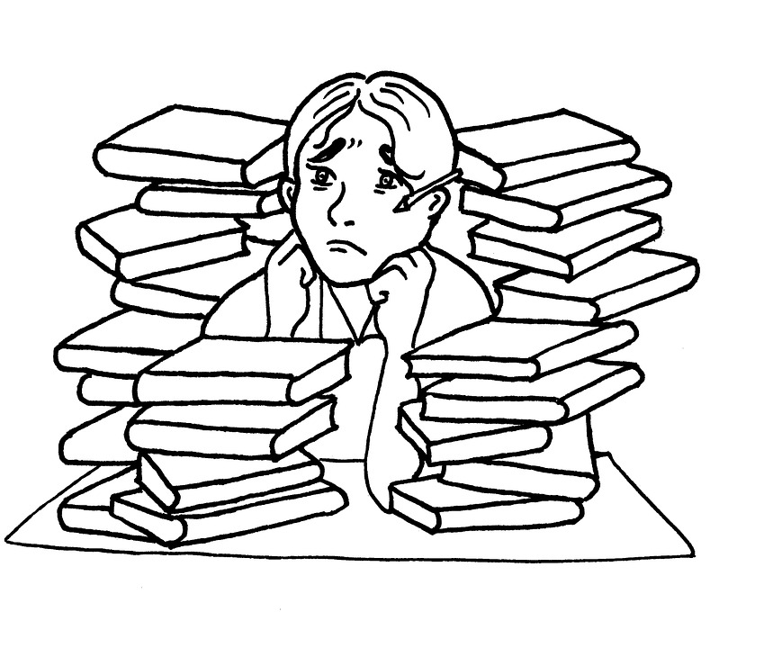
Your turn
Think of a literacy strategy (or other general strategy) that you will commit to implementing in your classroom this school year.
Be prepared to report your idea to the rest of the department in 15 minutes.
Each of you will keep data on your chosen strategy this school year and we will have a culminating discussion at the end of the year during post-planning.

